Slide 1


CUSTOMER SEGMENTATION
USING K-MEANS CLUSTERING
Course Title – R Programming (SEC)
Team Members
N.Ashwitha (120422539008)
V.Pravalika (120422539010)
C.Manasa (120422539020)
Program – B.Sc.
Combination – MSDS
Year - II

Slide 2

INTRODUCTION
Today’s competitive retail landscape,understanding customer behavior.
Utilize K-means clustering to segment mall customer.
Identifying distinct customer groups, we can develop targeted marketing strategies.

Slide 3


OBJECTIVES
01
03
Using K-means clustering
Explore the distribution
based on demographics and spending data.
customer features (gender, age, income, spending score).
02
04
Analyze customer segments
Recommend marketing strategies
extract insights into customer behavior
tailored to each customer segment

Slide 4

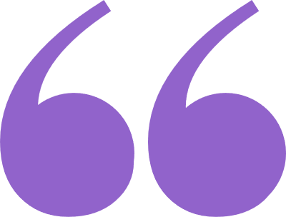

LITERATURE REVIEW
Customer Segmentation Techniques: A Comprehensive Review
by Smith and Brown (2017)
Provides a broad overview of customer segmentation techniques.
Unsupervised Learning Algorithms for Customer Segmentation: A Comparative Analysis
by Garcia and Lee (2019)
Focuses on the application of unsupervised learning algorithms like K-means for customer segmentation.

Slide 5

DATA AND METHODOLOGY
Data source: mall's internal database (membership card information)
Data description:
Customer ID
Gender (male/female)
Age
Annual Income (in thousands)
Spending Score (based on buying behavior)
Methodology:
K-means clustering algorithm for customer segmentation
Exploratory Data Analysis (EDA) to understand data distribution

Slide 6
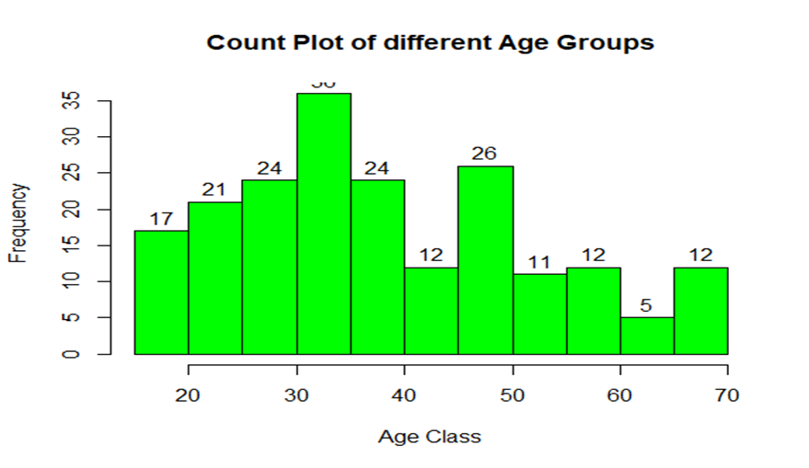
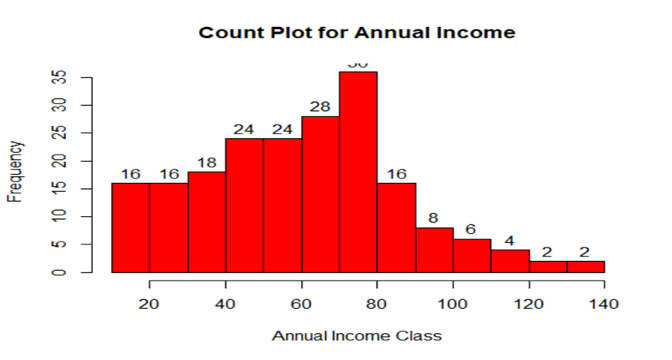
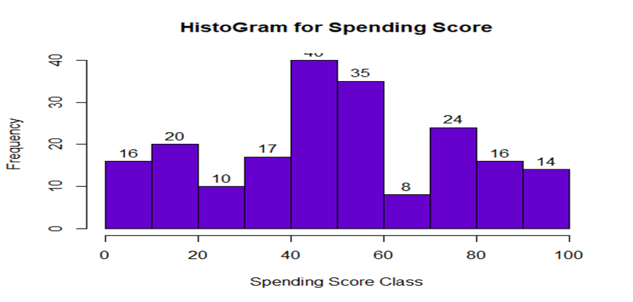
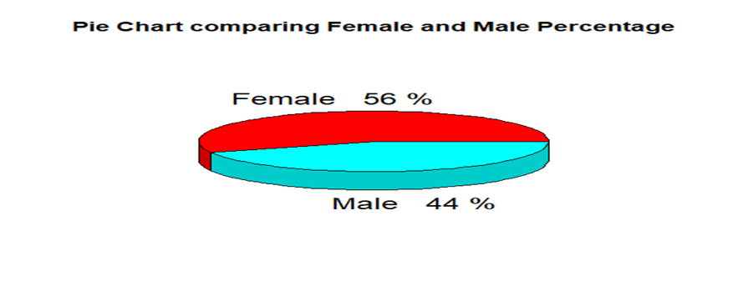
DATA VISUALIZATION

Slide 7
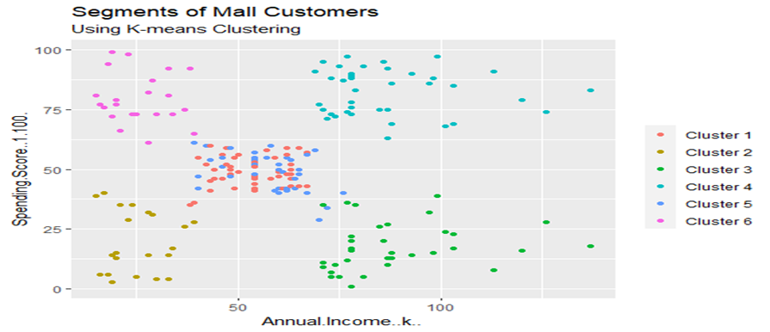
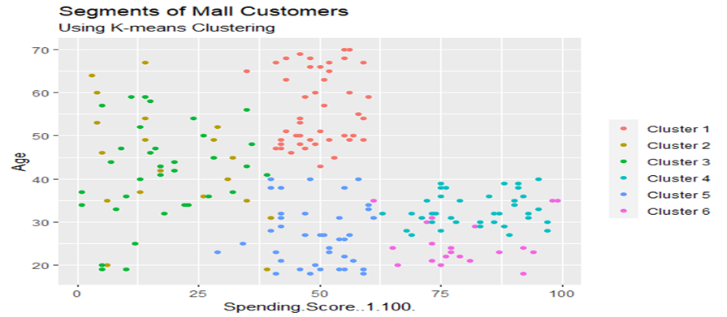
RESULT

Slide 8
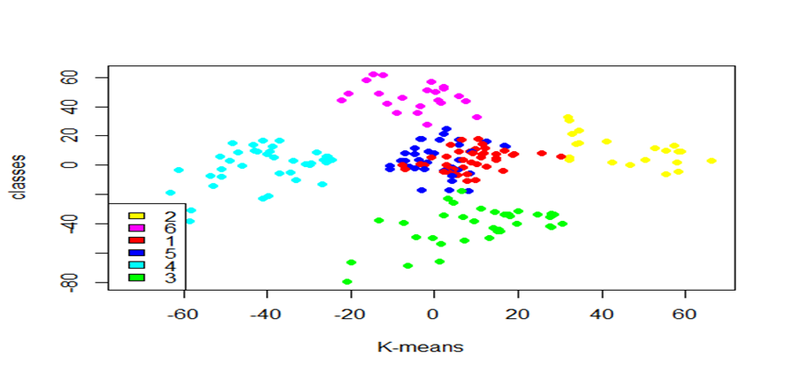
RESULT

Slide 9
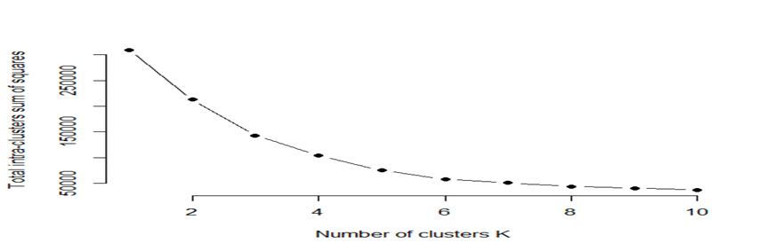
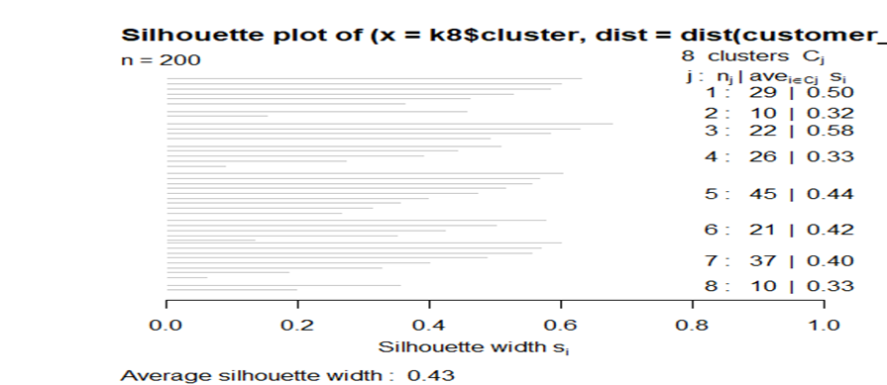
Intra Clustering
Silhouette plot_8

Slide 10





By implementing these data-driven strategies, the mall can gain a significant competitive advantage, fostering customer loyalty and driving long-term business growth.
CONCLUSION
Increased customer engagement
Improved sales and marketing ROI
Stronger customer relationships

Slide 11



